Slide 1





ECO THRIVE MARKET
Team Members:
SAI NARAYANA A Guide: UMA MAHESHWARI R
SURYA TEJA K
RAVI TEJA K
DINESH K P
SWETHA A

Slide 2
OUTLINE
Abstract
Problem Statement
Aims, Objective & Proposed System/Solution
System Design/Architecture
System Development Approach (Technology Used)
Algorithm & Deployment
Conclusion
Future Scope
References
Video of the Project
Notes:
These are the list of chapters that we are going to cover in these foundation codes. Those are chapter one what are AI and ML? chapter 2 applied Python programming in AI, and chapter 3 is exploratory data analysis for ML.

Slide 3
Abstract
There is a clear gap in the market as a result of the growing demand for eco-friendly products brought about by the increased awareness of environmental sustainability. This disparity results from the difficulty in establishing connections between consumers who care about the environment and trustworthy vendors of sustainable products. The Eco Thrive Market project seeks to close this gap by launching a specialized platform in response. This platform will function as a marketplace, enabling the smooth exchange of information between environmentally concerned consumers and reliable providers of sustainable goods. Eco Thrive Market wants to create a thriving ecosystem where customers can readily find and support ecologically friendly solutions by utilizing technology to improve accessibility and transparency.

Slide 4
Problem Statement
A gap in the market has been brought to light by the rising demand for sustainable products and the difficulty in matching environmentally conscious customers with reputable eco-friendly suppliers. In order to close this gap, Eco Thrive Market offers a marketplace that selects and advertises eco-friendly goods while guaranteeing ease of use, authenticity, and transparency for both customers and sellers.

Slide 5
Aim and Objective
Aim:
The aim of the Eco Thrive Market project is to establish a comprehensive and user-friendly online marketplace that promotes sustainable living by providing a centralized platform for eco-conscious consumers to discover, compare, and purchase a diverse range of environmentally friendly products.
Objectives:
Create a User-Friendly Platform.
Support and Promote Sustainable Organic Products.
Encourage Farmer’s Community Engagement.
Educate and Raise Awareness.

Slide 6
Proposed Solution
The proposed solution involves the establishment of a specialized marketplace, leveraging technology to facilitate seamless information exchange between consumers and reliable providers of sustainable goods. The project acknowledges the challenge of connecting environmentally conscious consumers with trustworthy sustainable product vendors. Eco Thrive Market aims to bridge the existing gap in the market fueled by the escalating demand for eco-friendly products amid heightened environmental awareness. In existing systems there is no relationship between vendors and customers but in our project we proposed a system that vendors directly connect with the customers. This will make easier to the customers and make community engagements.

Slide 7
System Architecture
Customer Module:
Customer
Register
Login & Logout
Browse
Categories
Add Products
to Cart
Fill delivery details

Slide 8
Farmer Module:
Farmer
Login
Add & Delete goods from inventory
Approves the
Payment status
Check Activities
Logout

Slide 9
Algorithm
Algorithm: User Authentication
Input:
- $_POST['email']: User-provided email
- $_POST['pass']: User-provided password
- $_POST[‘image']: User-provided Image
- $conn: Database connection object
- $_SESSION: PHP session variable
- $message: Array to store messages
1. Retrieve user-provided email and password from the POST request.
- $email = $_POST['email'];
- $pass = md5($_POST['pass’]);
2. Prepare an SQL statement to select user data from the 'users' table based on the email and hashed password.
- $sql = "SELECT * FROM users WHERE email = ? AND password = ?";
3. Prepare a PDO statement for executing the SQL query.
- $stmt = $conn->prepare($sql);

Slide 10
Algorithm
4.Execute the SQL query with the sanitized email and password.
- $stmt->execute([$email, $pass]);
5.Get the number of rows returned by the SQL query.
- $rowCount = $stmt->rowCount();
6.Fetch the user data as an associative array.
- $row = $stmt->fetch(PDO::FETCH_ASSOC);
Successful authentication may set session variables and redirect the user.
Failure to authenticate may populate $message with relevant error messages
End Algorithm

Slide 11
Deployment Steps
Set Up the Database:​
- Create a MySQL database with a table named users containing fields like username, email, password and image.​
Create Config.php:​
- Create a PHP script (Config.php) responsible for establishing a connection to the MySQL database. Make sure to handle errors gracefully.​
Deploy PHP Script:​
- Place the PHP script containing the provided code on your web server. Ensure it is accessible via the appropriate URL.​
Configure Server Environment:​
- Ensure that your server environment supports PHP and MySQL. For that install Xampp server
5.Test the Application:​
- Test the login functionality thoroughly to ensure it works as expected.​
- Check for any security vulnerabilities, such as SQL injection or session fixation attacks.​
6.Monitor and Maintain:​
- Regularly monitor your application for errors and security vulnerabilities.​
- Keep your server software, including PHP and MySQL, Xampp server up to date with the latest patches and update
​

Slide 12
Technology Used
Operating System: Windows​
Front-End: HTML, CSS, JavaScript​
Back-End: PHP
Data-Base: MySQL​
Server: Xampp Server

Slide 13
Conclusion
In conclusion, the Eco Thrive Market project aims to address the increasing demand for sustainable products by establishing a platform that connects environmentally conscious consumers with reputable eco-friendly suppliers. By providing a centralized marketplace, the project seeks to foster a sustainable ecosystem, catering to the needs of both consumers and suppliers in the ever-growing market for eco-friendly products. Through this initiative, the project envisions contributing to a more environmentally conscious and thriving marketplace.

Slide 14
Future Scope
The future scope of your project, Eco Thrive Market, is vast and promising. Here are some potential directions:
Expansion of Product Categories: As the demand for sustainable products grows, you can expand the range of product categories offered on the platform. This could include everything from clothing and accessories to home goods, beauty products, and even food items.
Global Reach: While starting locally or nationally, there’s a huge potential for expanding the services globally. This would connect eco-friendly suppliers and consumers worldwide, making sustainable products more accessible.
Technology Integration: Leveraging technology like AI and machine learning could enhance user experience through personalized recommendations, better search functionality, and efficient customer service.

Slide 15
References
https://www.collegenutritionist.com/blog/8-benefits-of-organic-food/
https://www.strategy-business.com/article/The-rise-of-the-eco-friendly-consumer
https://www.indianretailer.com/article/whats-hot/retail-trends/rise-of-eco-friendly-products-in-indian-market.a7723
Notes:
Reference
These are the references for this session.
15

Slide 16
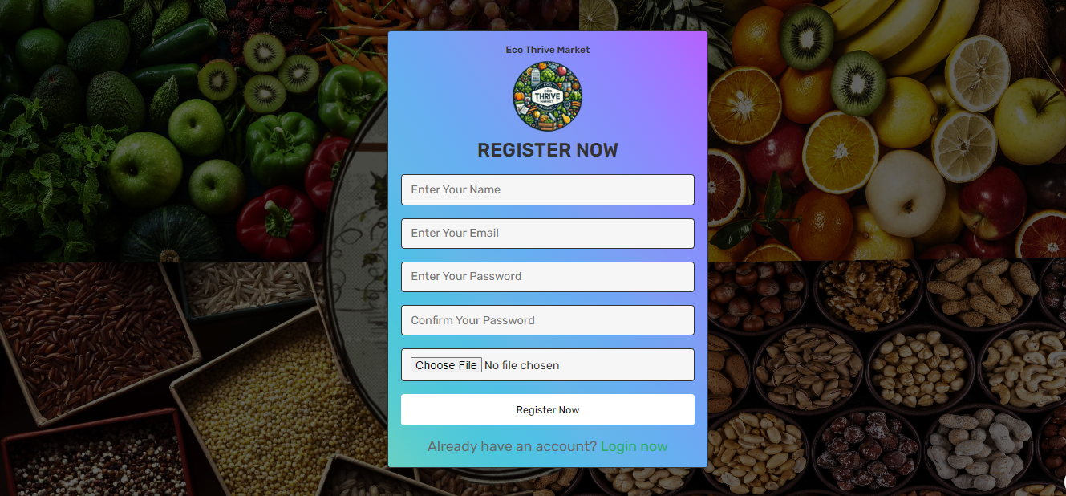
Frontend part
Register Page:

Slide 17
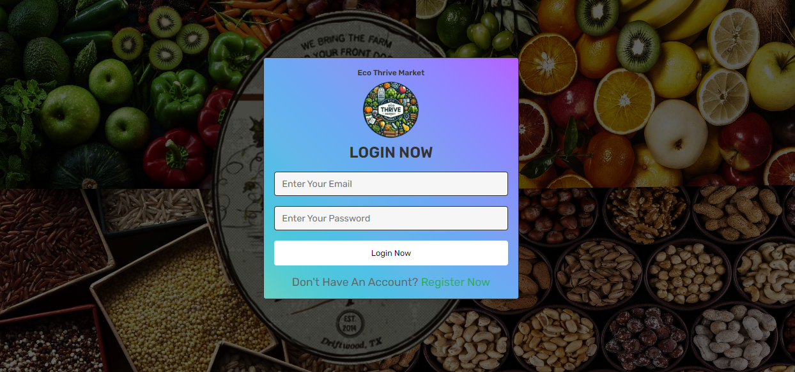
Frontend part
Login Page:

Slide 18
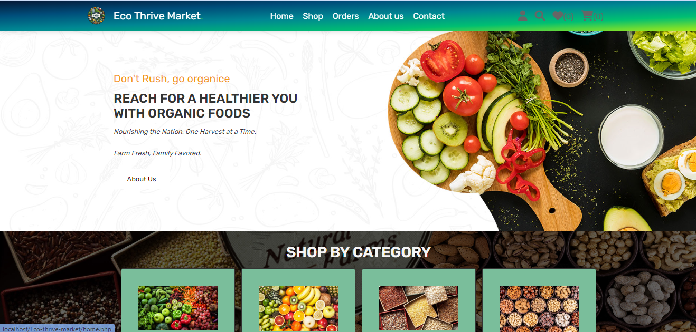
Frontend part
Home Page:

Slide 19
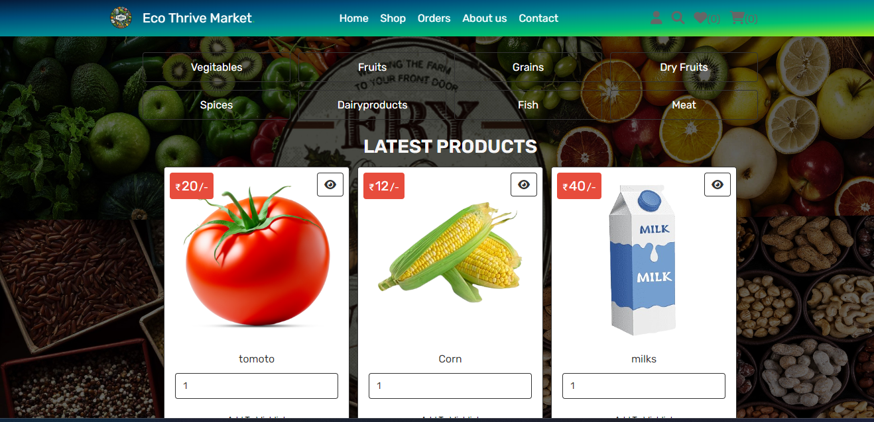
Frontend part
Shop Page:

Slide 20
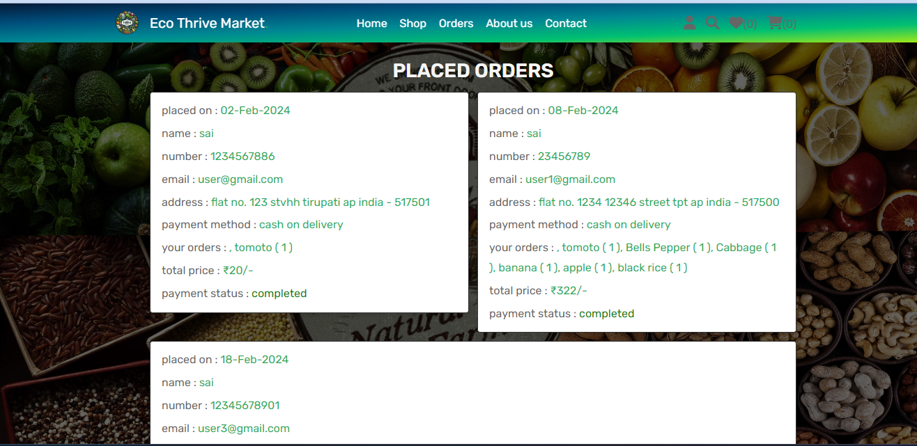
Frontend part
Orders Page:

Slide 21
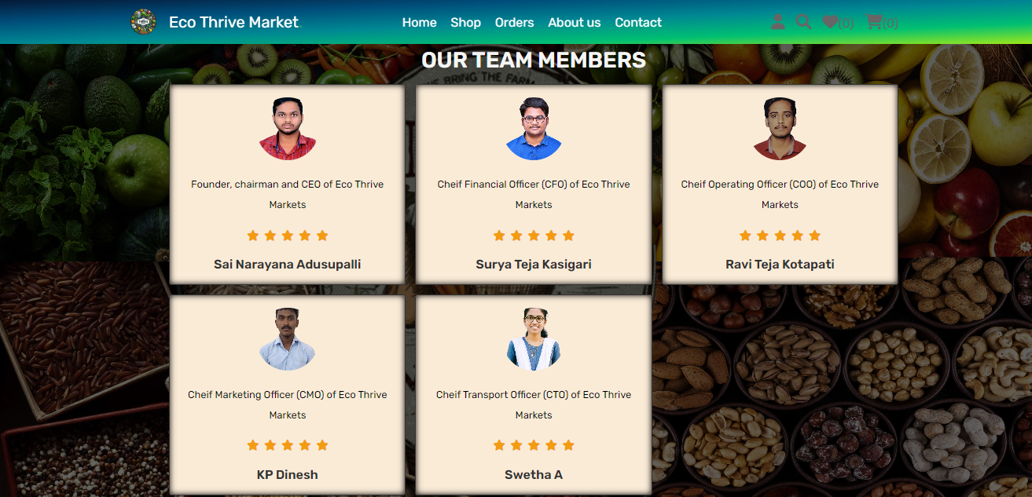
Frontend part
About us Page:

Slide 22
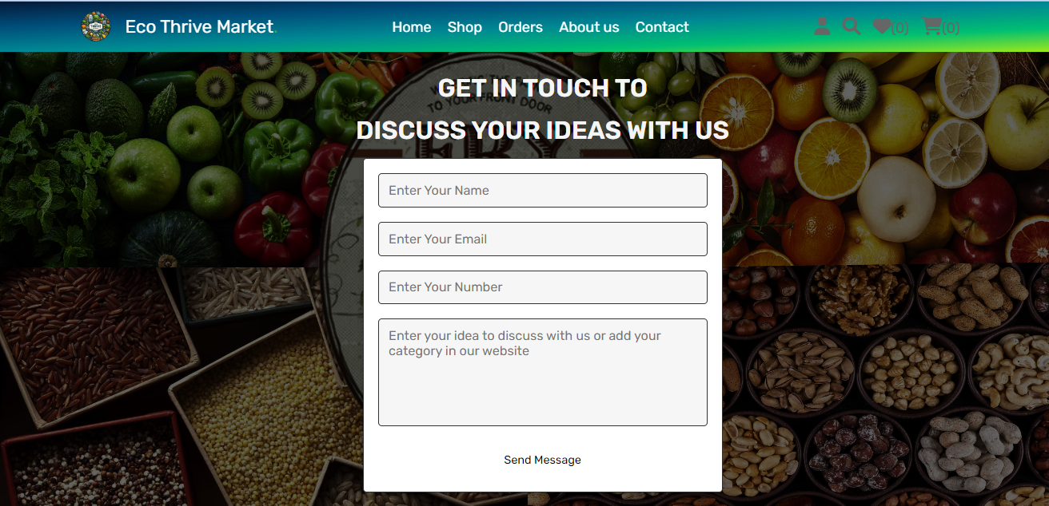
Frontend part
Contact Page:

Slide 23
Project Demo Links:
GitHub Link:
https://github.com/SURYA2745/ECO-THRIVE-MARKET
Video Demo Link:
https://drive.google.com/file/d/18vywcOa0PdBkFwzUQqCL5OUvgYegbP0z/view?usp=sharing

Slide 24
Thank you!
Notes:
thank you very much for joining this PPT, keep learning.
24

